Slide 1
Large Scale Applications of Concurrent Objects
-Second Life, Twitter Systems, and
Molecular Dynamics Computing-
Christmas Lecture
Akinori Yonezawa
University of Tokyo, December 22, 2009

Slide 2
What is this talk all about?
… talking about a way to construct
a large software system on
(massively) parallel distributed computers

Slide 3
A Software System is…
A software system is composed of many software modules (parts).
  Just like a car is composed of many physical parts.
Modules (parts) must be:
  fairly independent from its surrounding components,
  composable to form a larger module using other modules
  replacable by other module with the same functionality
  etc.

Slide 4


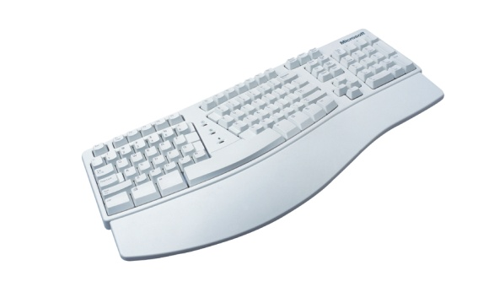
A Software System is composed by software modules..
Communication module
Web Browser System
Display drawing module
Module receiving user input
Notes:
誰でもわかりそうなソフトウェア、ということでウェブブラウザにしました
4

Slide 5
Object:
a form of software modules/parts
Since１９５０’s , the following forms:
  subroutines
  functions
  procedures
  abstract data types
  etc
Since the advent of Java language, the “object” form of software module is prevailing in software system construction !!!

Slide 6
What’s an Object
Data/data-structures and methods using the data are encapsulated together in an Object!!
An object encapsulates data and methods using the data.
Data ,
Data Structure
Functions/
Procedures/
methods

Slide 7
Concurrent Object is a Generalization of Objects!!
I came up with this idea in mid 70’s.

Slide 8
Concurrent Object (CO)
concurrent
object
＝
object
cpu/thread
1. CO encapsulates a statefull object + a singlecpu/thread.
２．COs transmit/exchange messages
concurrently and asynchronously.
Notes:
Discussions with C. Hewitt and other graduate students helped a lot to form the idea of “concurrent Objects”. AT that time the idea was not
called concurrent objects, rather, it is called “actor” as my advisor was Carl Hewitt. Carl does not like the idea of Actor that has persistment sore/memory.
He was pursuing soft of functional approach/stateless approach

Slide 9
Both Modeling and Programming
In mid 70’s,I started being interested in:
modeling worlds and
simulate them on computers!
powerful programming frameworks!

Slide 10
in computer science comm. Of Mid 70’s,
IC is maturing and time-sharing systems are in use
ARPA Net is expanding…
A bright future of ＶＬＳＩ was envisaged.
  C. Mead & L. Conway, Intro. VLSI Design, 1979
Time to prepare ourselves for abundance of inexpensive microprocessors
Start developing technology for utilize them

Slide 11

My view in 70’s:
Modeling and Simulation by Concurrent Objects
Real World
Concurrent Objects &
their message passing
modeling
representing
WEB/net
things, people, computers & their interactions
Notes:
Our domains today have more variety of objects to be modeled..

Slide 12
Crucial Features of Concurrent Objects
Message/event-driven activation/processing
Asynchronous message transmission
Information sharing only through message passing
Control flow and message flow coincide
Massive parallelism through massive concurrent objects
Enables safe use of safe light-weight processes
  No need for lock/unlock operations

Slide 13
Parallelism in a domain/world can be naturally/directly modeled with COs
In domains,
Rain drops fall in parallel.
Things exit in parallel.
Parallelism by an ensemble of many COs
State change of a thing is reflected by state change of the CO.
  COs move in V-space as things moves in space.
COs interact with message transmissions as things interact.

Slide 14
1．Message/Event Driven
Concurrent Object
thread
Ｍ
Concurrent Object

Slide 15
2．Asynchronous message passing
C1
C2
C1
C2
C1
C2
Type１
Type２
Type３(future)

Slide 16
３．Information sharing is possible,
only through message passing,
Concurrent object
thread
Concurrent object
thread
×
×
×
×
memory

Slide 17
What can be modeled and represented by ＣＯs
Mass, particle、structures
Human, agent,
More abstractly…
Virtual processor （ＶＰ）, light-weight thread
Fine parts and processing units obtained by partition of large problem
Huge task & problem
co
co
co
co
co
co
co
co
co
co

Slide 18
Large Scale Applications of COs
Second Life system
Twitter system
NAMD, a nano-bio molecular dynamics simulator for supercomputers

Slide 19
Which CO’s advantages enable large scale applications?
Natural modeling power
Second Life -- simple and powerful description
2. Parallel programming
with safe high performance
  Twitter, Facebok
3. Parallel programming
with high performance and high productivity
  Charm++ → NAMD → analysis of molecular structures of Swine Flu

Slide 20
Second Life

Slide 21

Back to Original Motivation of COs
Real World
Concurrent Objects &
Message Passing
Modeling
WEB
Representing
Entities,people,machines & their interactios
Linden’s Second Life …
is a natural outcome from the motivation of Cos.

Slide 22
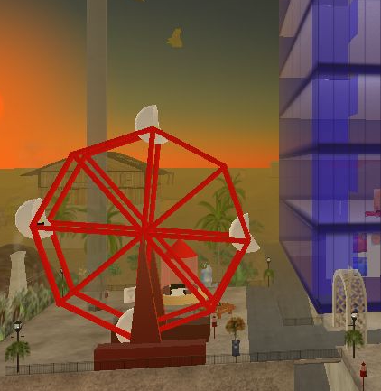
Concurrent Objects in Second Life
Linden’s online Virtual World that millions people participate in!
elevator
When a man gets
In Ferris Wheel, it
starts to rotate.
Objects and avatars
are represented and programmed as concurrent objects!!
Image from “Programming Second Life with the Linden Scripting Language” by Jeff Heaton (http://www.devx.com/opensource/Article/33905)

Slide 23
COs in Second Life
Jim Purbrick, Mark Lentczner,
“Second Life: The World’s Biggest Programming Environment”,
Invited Talk at OOPSLA2007, said:
  Objects and avatars cooperate and coordinate each other by exchanging messages.
  each object or avatar is programmed to
    Have its own state,
    Have its own method to respond to an incoming message,
    Have different responses to different states, and
    Have its own thread.
  About 2 millions of objects are programmed in Second Life and they are in action.
COness!

Slide 24

Second Life Teleporting Demo
テレポート（4次元での移動）する

Slide 25
Twitter

Slide 26

Joichi Ito (伊藤 穣一）talks about Twitter

Slide 27
Twitter System
    Over 100 millions people are using it
Twitter System
つぶ
やき
つぶ
やき
つぶ
やき
つぶ
やき
つぶ
やき
つぶ
やき
つぶ
やき
つぶ
やき
つぶ
やき

Slide 28
COs in Twitter
Implementing Twitter System requires:
a huge number of twitters need to be processed in parallel.
accomplished by using a huge number of COs!!
The CO/actor mechanism in Scala language is employed!
Ruby on Rails was used in an old version of Twitter.

Slide 29
Implementation of Twitter System
Requests from clients are processed by COs
a large number of twitters are processed by a large number of COs
COs enable a simple construction
of the stable and fast system.
処理プログラム
Each
processing code is CO
処理プログラム
処理プログラム
Twitter システム
fast・elegant
処理プログラム
処理プログラム
Procesing code
Procesing code
Procesing code
つぶ
やき
つぶ
やき
つぶ
やき
つぶ
やき
つぶ
やき
つぶ
やき
つぶ
やき
つぶ
やき
つぶ
やき

Slide 30
Why COs are Used?
Robey Pointer says：
When a client logins, a CO is created and waits for twitters to come.
Use of COs makes the program very simple!!
－ owing to the nature of message-driven and asynchronous messages
  － Krestel (Core of the system) is written by 2000 lines of code
Enables fast processing, and load balancing
（At peak, 10 thousands twitters are processed)
－ a huge number of COs make load balancing possible
No more than one thread is contained in a single CO.
  － Lock/unlock operations are unnecessary!!!
Handling the twitter queue is possible by a large number of threads for an ordinary load, but still difficult and unsafe for lock/unlock operations --- Program safety is hard to gurantee!!

Slide 31
KESTREL
(http://github.com/robey/kestrel)
Core software modules in Twitter System
which handles client messages(twitters)
Used as backend for Twitter System
    http://blog.twitter.com/2009/01/building-on-open-source.html

Slide 32
Kestrel
Message queue hand system written in language Scala
  CO/actor facilities supported in Scala are extensively used.
  The code is only 2000 lines long!!
  Tens of thousands of parallel processing by CO/actors

Slide 33
Scheme of Kestrel
Requests from clients are processed by CO/actors
  For each client, a CO/actor is dynamically created.
  E.g., 7000 CO/actors for 7000 login clients in parallel
Queue
client
CO/actor
CO/actor
client
CO/actor
CO/actor
CO/actor
client
client
client

Slide 34
NAMD
(Nano-scale Molecular Dynamics Simulator)

Slide 35
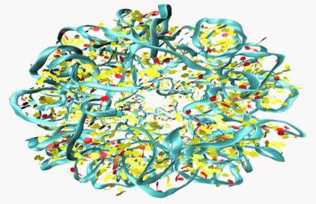
NAMD[1996]
Nano scale molecular dynamics simulator for supercomputers
Received Gordon Bell Prize in 2006
Developed jointly by two groups in Illinois Univ.
Prof. Sanjay Kale (Computer Science)
Prof. Schulten (Theoretical Biology)
Written in Concurrent Object-based system Charm++
“NAMD is a parallel, object-oriented molecular dynamics code designed for high-performance simulation of large biomolecular systems.”
Simulate step by step, each step representing 1 fs.
At each step, calculate forces exorted on all molecules and update their positions and velocities

Slide 36
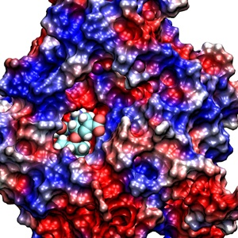
This still from a Quicktime movie represents a view of the drug buried in the binding pocket of the A/H1N1 neuraminidase protein.
Molecular Structure

Slide 37
Charm++[1993]
CO-based language system for parallel/supercomputers developed by Prof. Kale.
-- many references to our CO-based language ABCL
Used for development of NAMD, OpenAtom（quantum chemistry）, ChaNCA（Galaxy generation）
Operational for machines with 1000~10000 CPUs
Has a framework for dynamic load balancing by moving Cos from node to node
Applications written in Charm++ are
  Utilizing and consuming 15%~20% of computing resources intwo major supercomputing centers in US

Slide 38
Goals of Charm++
CO-based programming system for supercomputers http://charm.cs.uiuc.edu/
Goals：
  Improve performance of parallel applications for regular and dynamic problems
  Improve productivity of programmers an programming

Slide 39
Analysis of Molecular Structure of Swine Flu by NAMD
Showed:
Structural changes of A/H1N1 protein induce anti-tamiful effects.

Slide 40
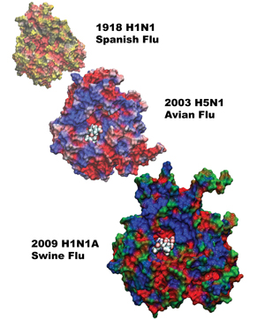

Slide 41
Towards Many-Core Machine Era

Slide 42
Multi-Core (Many-Core) Chip
4 ~ a few hundreds of CPUs on a single chip
Laptop with 30~40core machine, in 5 years
cpu
cpu
memory
cpu
cpu

Slide 43
New Type of Supercomputers
100K ~ 1000K machines (node) connected each other!!!
Each node contains 16> cores

Slide 44
How to Program
Many-Core Machines and Supercomputers
Programming easily and efficiently is a big problem!!
Main problems:
  Synchronization between processes(CPUs)
  Communications between processes
  Deadlock avoidance
  Developing parallel algorithms

Slide 45
A Solution
Concurrent-Object based Programming (CO)
Concurrent Object-Oriented Programming(COOP)

Slide 46
End

